Slide 1
Data 102: Lecture 5
Moritz Hardt
UC Berkeley, Spring 2020

Slide 2
Announcements
We’ve moved.
If you’re reading this, you came to the right room!
Genetics & Plant Bio 100

Slide 3
Last few times

Slide 4
Statistical decision-making framework
Data X
Parameter θ, or label Y, hypothesis H
Decision rule δ(X), loss function L(δ(X), θ)
Possibly joint distribution P over X and θ

Slide 5
What do optimal decisions look like?
Risk formulation
Minimize Bayes risk R(δ) = E[L(δ(X), θ)]
Bayes optimal solution for squared loss is the conditional expectation δ(X) = E[θ | X]

Slide 6
What do optimal decisions look like?
Neyman-Pearson formulation
Maximize true positive rate of δ
s.t. false positive rate ≤ 𝛼 (e.g. 0.05)
Optimal solution is Likelihood Ratio Test δ(X) = 1{ L(X) > t }

Slide 7
What about many tests/decisions?
How do we avoid false discoveries when running many hypotheses tests?
Bonferroni/union bound to control probability of at least one false discovery
Benjamini-Hochberg procedure controls false discovery rate

Slide 8
Today: Fairness in decision-making

Slide 9
Disclaimer
Fairness in decision-making is a broad topic drawing on numerous fields
We’ll study this topic in a our simple statistical setting
Even this setting already leads to deep problems
But it’s just a glimpse at the subject
In particular, fairness is not a purely technical problem

Slide 10
Same setup as before
Features X
Target variable Y (aka called parameter θ in previous lectures)
Decision rule δ(X)
Typically δ(X) = 1{R(X) > t} threshold rule, where R could be:
likelihood ratio test (recall, Neyman-Pearson)
conditional expectation (recall, Bayes optimal score)
score learned from data (future lectures)
Loss function L(δ(X), Y)

Slide 11
One important complication
In many real-world applications, our features X contain sensitive attribute A
Assume A is a discrete random variable partitioning population into groups a, b, c, ...
Examples: race, gender, disability status, etc.
This lecture: How do we avoid making decisions that discriminate based on the sensitive attribute?

Slide 12
Legally recognized ‘protected classes’ in the US
Race (Civil Rights Act of 1964); Color (Civil Rights Act of 1964); Sex (Equal Pay Act of 1963; Civil Rights Act of 1964); Religion (Civil Rights Act of 1964); National origin (Civil Rights Act of 1964); Citizenship (Immigration Reform and Control Act); Age (Age Discrimination in Employment Act of 1967); Pregnancy (Pregnancy Discrimination Act); Familial status (Civil Rights Act of 1968); Disability status (Rehabilitation Act of 1973; Americans with Disabilities Act of 1990); Veteran status (Vietnam Era Veterans' Readjustment Assistance Act of 1974; Uniformed Services Employment and Reemployment Rights Act); Genetic information (Genetic Information Nondiscrimination Act)

Slide 13
Regulated domains (based on US law)
Credit (Equal Credit Opportunity Act)
Education (Civil Rights Act of 1964; Education Amendments of 1972)
Employment (Civil Rights Act of 1964)
Housing (Fair Housing Act)
‘Public Accommodation’ (Civil Rights Act of 1964)
Extends to marketing and advertising; not limited to final decision
This list sets aside complex web of laws that regulates the government

Slide 14
Fairness through unawareness?
Can we avoid this whole mess by removing/ignoring all sensitive attributes from our data?

Slide 15
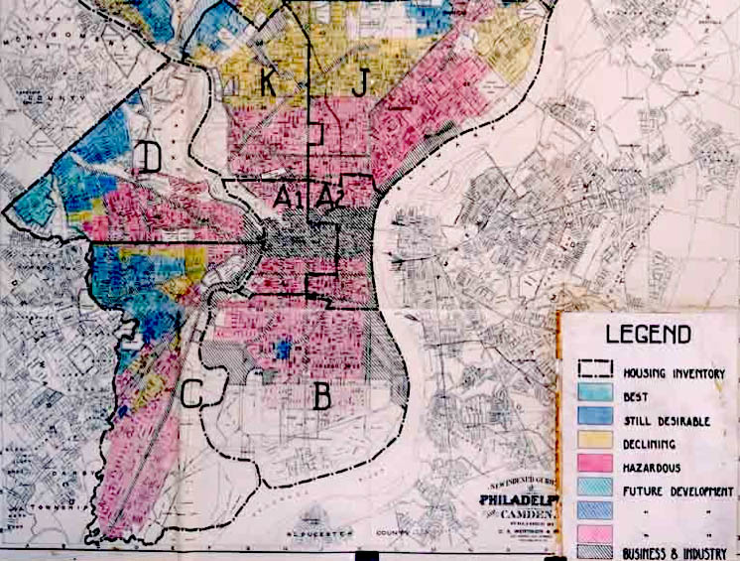
Notes:
A 1936 HOLC "residential security" map of Philadelphia, classifying various neighborhoods by estimated riskiness of mortgage loans.^{[1]}

Slide 16
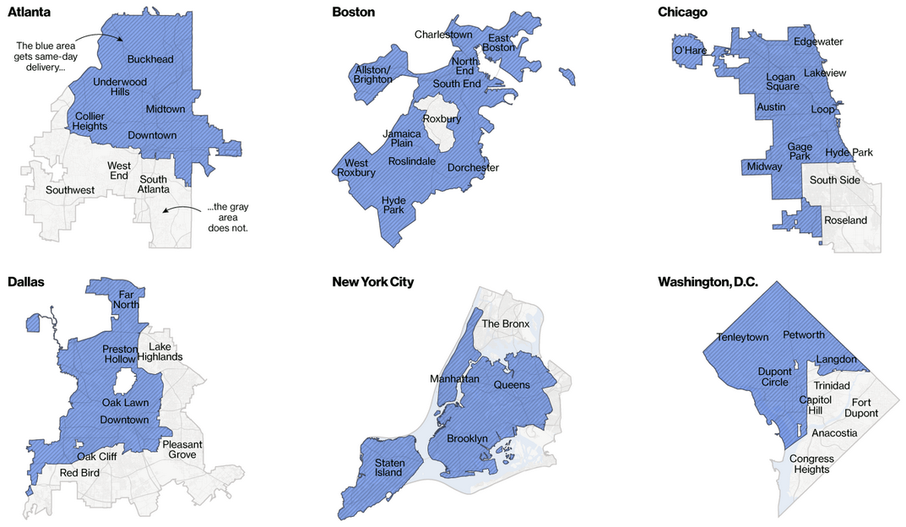
Amazon same-day delivery coverage
Source: https://www.bloomberg.com/graphics/2016-amazon-same-day/

Slide 17
The failure of fairness through unawareness
Machine learning is great at discovering “proxy variables”
If the sensitive attribute gives a boost in predictive accuracy, machine learning will likely discover
Perhaps Amazon was just predicting number of purchases, which correlates with affluence, which correlates with race in the United States. Amazon almost certainly did not look at their customers’ ‘race’ when they built this product.

Slide 18
“We didn’t look at that” is never a valid argument.

Slide 19
What else can we do?

Slide 20
Three common statistical fairness criteria
All answers to “equality of what?” question
Equalizing positive rate, i.e., acceptance rate
Equalizing error rates (“row-wise” rates)
Equalizing column-wise rates
Decision
0
1
n₀₀ | n₀₁
n₁₀ | n₁₁
0
Reality
1

Slide 21
Equalizing acceptance rate
Equal positive rate: For any two groups a, b, require P(δ(X) = 1 | A = a) = P(δ(X) = 1 | A = b)
“Acceptance rate” equal in all groups
Generalization: Require δ(X) to be independent of A.
Any concerns with this?

Slide 22
Why this does not rule out unfair practices
One unfair situation: Make good/informed decisions in one group, poor/arbitrary decisions in other groups. Equalize positive rate.
This can happen on its own if we have less data or poor data in one group.
Example: Old Framingham risk score for coronary heart disease was created on cohort of white men, then used for other patients.
A positive call could be a false positive or a true positive. You shouldn’t be able to match true positives in one group with false positives in another.

Slide 23
Equalizing error rates (“row-wise rates”)
For any two groups a, b, require P(δ(X) = 1 | Y = 0, A = a) = P(δ(X) = 1 | Y = 0, A = b) (equal false positive rate) P(δ(X) = 0 | Y = 1, A = a) = P(δ(X) = 0 | Y = 1, A = b) (equal false negative rate)
These correspond to “row-wise” counts we saw.

Slide 24
Equalizing error rates (“row-wise rates”)
For any two groups a, b, require P(δ(X) = 1 | Y = 0, A = a) = P(δ(X) = 1 | Y = 0, A = b) (equal false positive rate) P(δ(X) = 0 | Y = 1, A = a) = P(δ(X) = 0 | Y = 1, A = b) (equal false negative rate)
These correspond to “row-wise” counts we saw.
Decision
0
1
n₀₀ | n₀₁
n₁₀ | n₁₁
Generalization: Require δ(X) to be independent of A conditional of Y.
0
Reality
1

Slide 25
Error rate parity is a post-hoc criterion
At decision time you don’t know who is a positive/negative instance
In hindsight, somebody can collect a group of positive instances and a group of negative instances and check how they were classified.
Group differences in this kind of post-hoc “audit” often strike people as unfair.

Slide 26
Interpretation in terms of ROC curve
Group a
Suppose δ(X) is threshold of a score δ(X)= 1{R(X) > t}
1
Group b
True positive rate
Error rate parity implies that ROC curve of score conditional on group must be under all curves.
0
False positive rate
1

Slide 27
Interpretation in terms of ROC curve
Group a
Suppose δ(X) is threshold of a score δ(X)= 1{R(X) > t}
1
Group b
True positive rate
Error rate parity implies that ROC curve of score conditional on group must be under all curves.
Area under all curves
0
False positive rate
1

Slide 28
Column-wise criteria?
We could consider P(Y = y | δ(X) = 1, A = a) and create analogous fairness criteria for the “column-wise” rates, i.e., false omission and false discovery rate.
This would correspond to the “column-wise” counts
Nothing wrong with this, but something related but different is more common.
Decision
0
1
n₀₀ | n₀₁
n₁₀ | n₁₁
0
Reality
1

Slide 29
Calibration
Suppose your decision is a threshold rule δ(X) = 1{ R(X) > t }.
Calibration: Pr(Y = 1 | R = r) = r
“You can pretend score is a probability” - although it may not actually be one!
Score r corresponds to positive outcome rate r
Calibration by group: Pr(Y = 1 | R = r, A = a) = r

Slide 30
Calibration is an a priori guarantee
The decision maker sees the score r = R(X) and knows based on this what the frequency of positive outcomes is.
E.g., score 0.8 means 80% rate of heart failure on average over people who receive score 0.8.
This guarantee (usually) does not hold at the individual level, e.g., “Joe’s individual risk of heart failure is 80%.”

Slide 31
Recap
We saw three criteria:
Equal acceptance rate
Equal error rates
Calibration by group
Can we have them all?

Slide 32
Incompatibility results
Informal theorem: Any two of these criteria are mutually exclusive in general.

Slide 33
Error rate parity vs calibration
Theorem: 1. Assume P(Y = 1| A = a) ≠ P(Y = 1| A = b) 2. δ(X) has nonzero error rates
Then, if error rate parity holds, group calibration cannot hold.
Proofs of theorems like these will be on the homework.

Slide 34
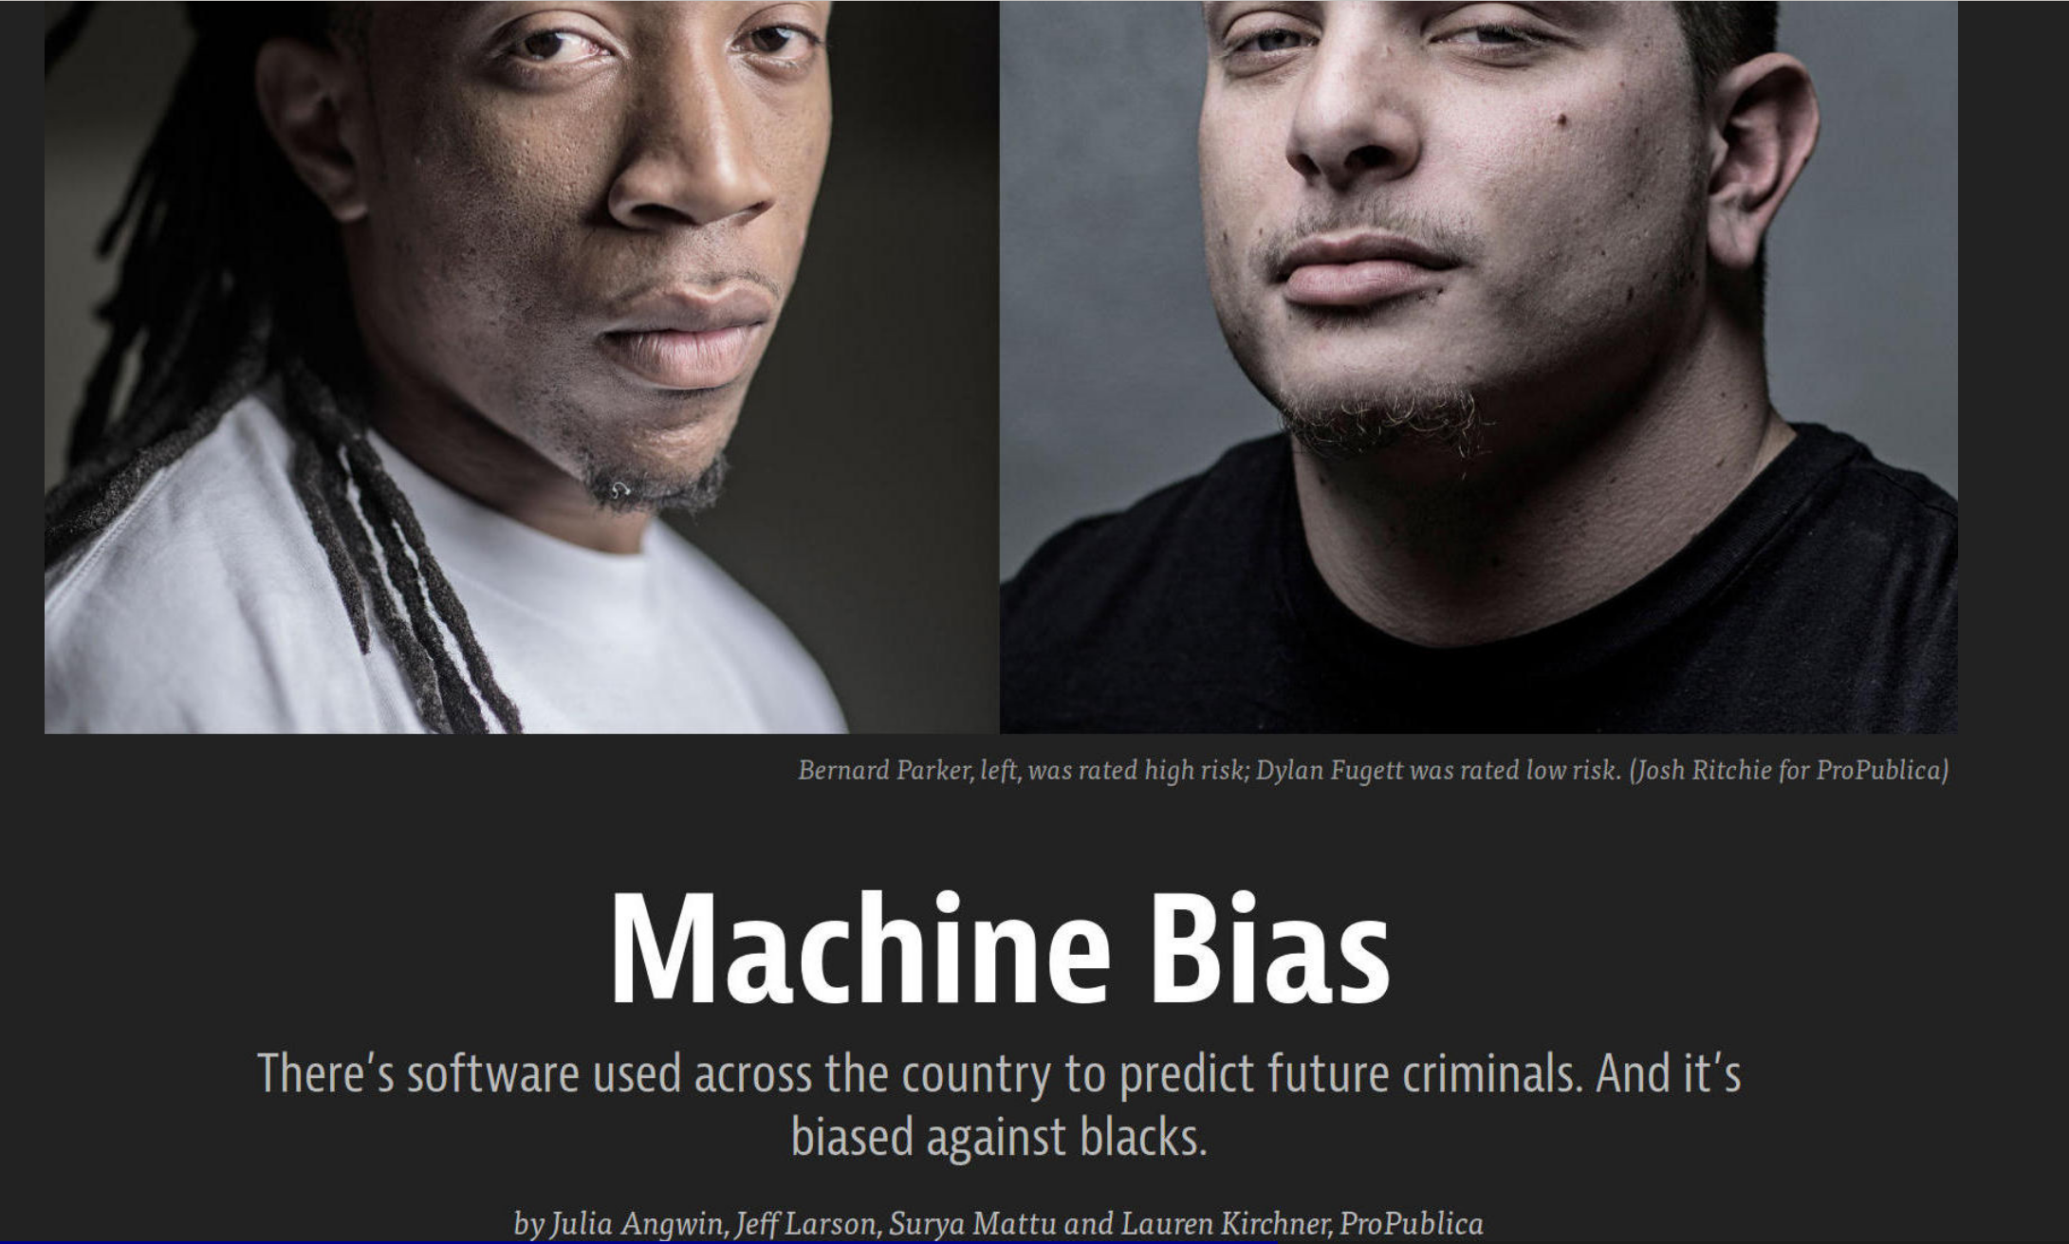

Slide 35
Essence of COMPAS debate
There’s a risk score used, called COMPAS, used by many jurisdictions in the United States to assess “risk of recidivism”. Judges may detain defendant in part based on this score.
ProPublica: Black defendants face higher false positive rate, i.e., more blacks labeled “high risk” end up not committing a crime upon release than among whites labeled “high risk”
COMPAS maker Northpointe: But our scores are calibrated by group and black defendants have a higher recidivism rate! Hence, this is unavoidable.

Slide 36
COMPAS as a Black Box
COMPAS states that the methodology used to determine a risk score is kept secret for capital reasons, making COMPAS a black box algorithm.
Black box algorithms (their computations and outputs) are impossible to understand by anyone other than those who have expertise in their creation. Many times, the implementation of an algorithm bars even its creator from understanding why specific outputs occur.
Because COMPAS is a black box we cannot discuss exactly how the creators controlled for certain factors. For example, ProPublica relied on analyzing post hoc outcomes because little other information was available to them.

Slide 37
Word of caution about COMPAS debate
Neither error rate parity nor calibration rule out blatantly unfair practices.
What’s fair in criminal justice is not settled by appeal to one or the other criterion.
These properties are not meant to be “fairness certificates”.

Slide 38
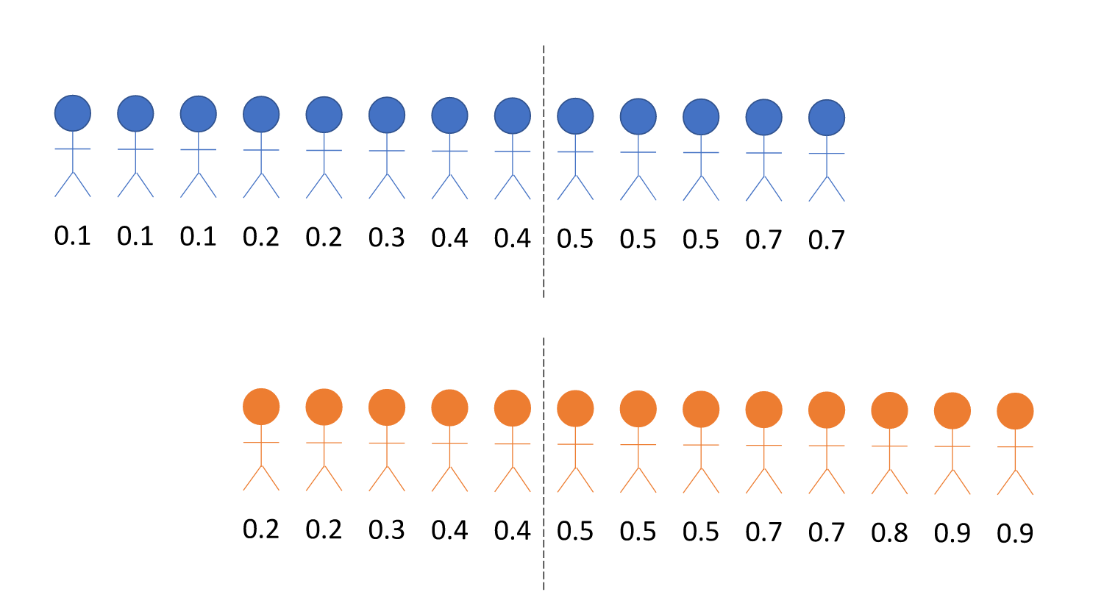
Consider these two groups
Detain everyone above 0.5
Detention rate | False pos. rate
38% | 25%
61% | 42%

Slide 39
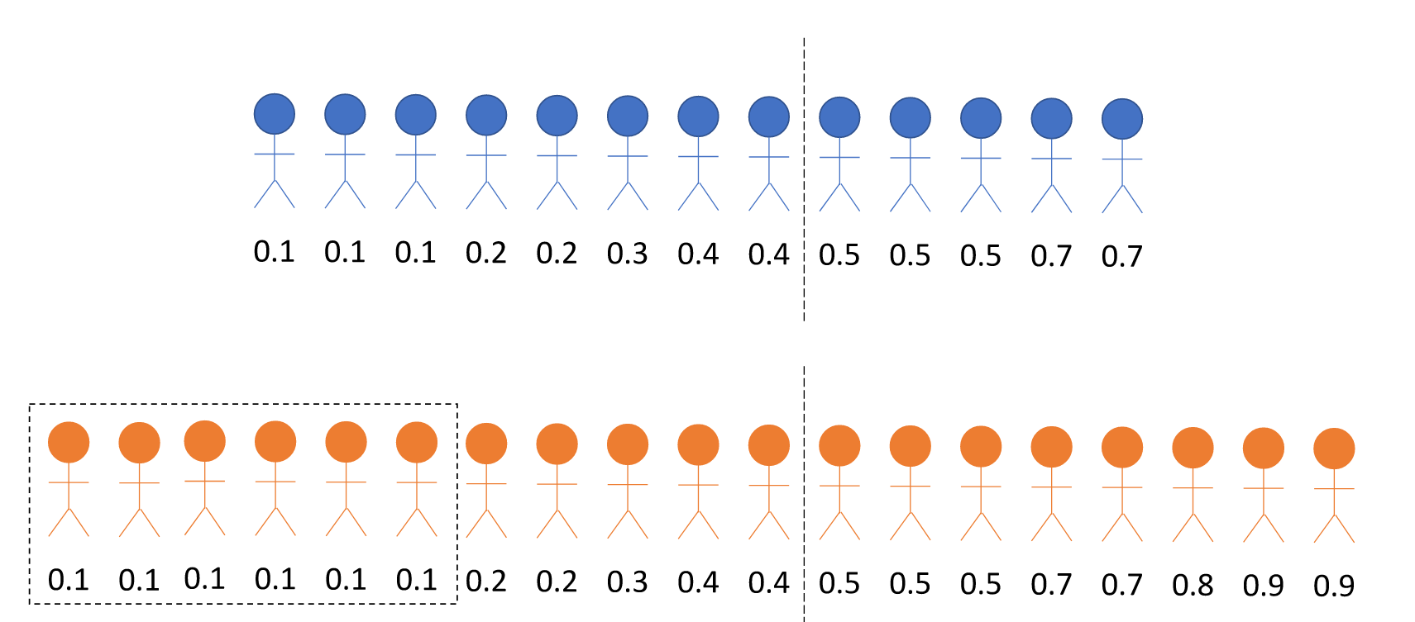
Equalizing rates may lead to undesired outcomes
Detention rate | False pos. rate
38% | 25%
61% 42% | 42% 26%
Arrest more low risk individuals in orange group!

Slide 40
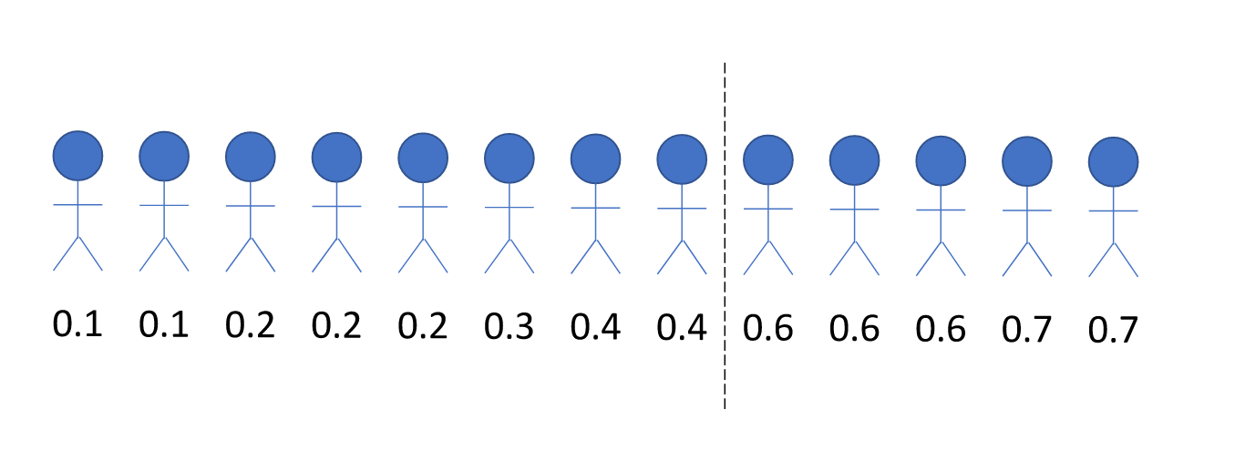
An issue with calibration
Detain everyone above 0.5
True probabilities of reoffending
(suppose we know them!)
Examples from: Corbett-Davies, Pierson, Feller, Goel, Huq (2017)

Slide 41
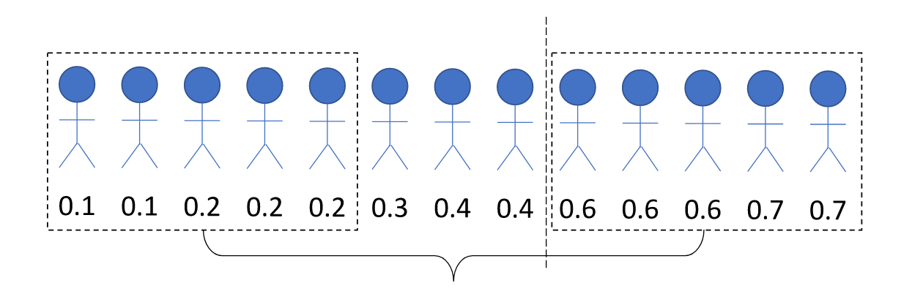
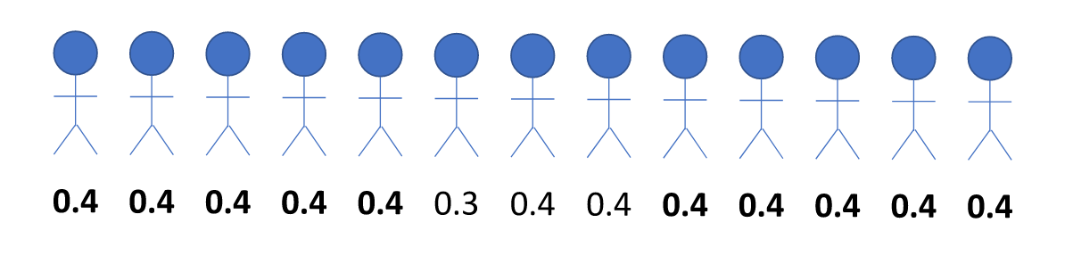
An issue with calibration
Average probability of re-offense is 0.4 in this subgroup
No one is detained!
Calibrated new scores

Slide 42
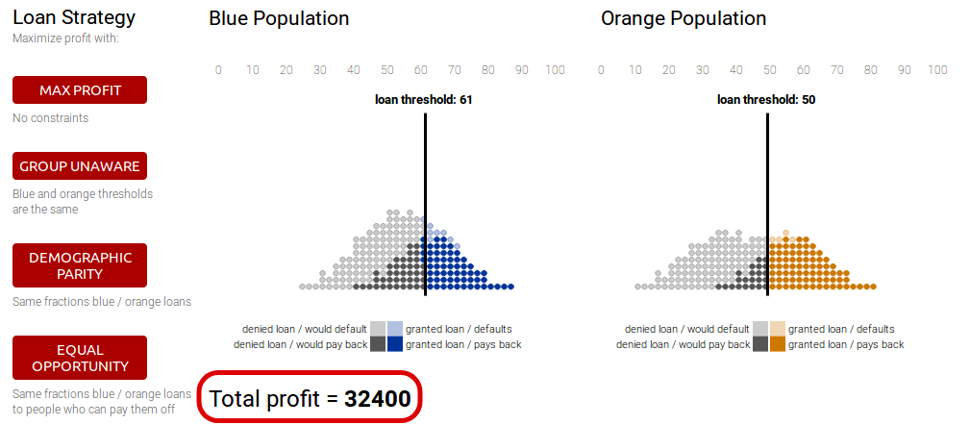
Visualizing trade-offs between criteria
https://research.google.com/bigpicture/attacking-discrimination-in-ml/

Slide 43
Tradeoff between Accuracy and Fairness?
What does it mean when a sensitive attribute makes a model more accurate?
Why isn’t overall accuracy fair to certain groups?
Does a general accuracy always represent the most optimal model?
What do we optimize for?

Slide 44
Accuracy and Fairness cont’d
For example, if we can create a classifier which is extremely accurate, but systematically unfair towards an identifiable class of people, it would be more accurate on average, but less accurate for many among that class of people.
This leads to systematic bias, meaning that the model entrenches already existing, historic biases. Federally protected classes and other types of regulation attempt to eliminate this kind of bias.
Thought for home: The federal government protects certain classifications, but not others. Should you always defer to their judgment on what attributes should be protected/controlled for?

Slide 45
How unaware is COMPAS’ “fairness through unawareness”?
COMPAS has subpopulations that they utilize to calibrate their algorithm and create the “most accurate” predictions possible. These categories include gender and legal status (i.e. prison/parole, jail, probation, composite).
Being that gender is one set of subcategories, COMPAS seems to recognize that the risk scores of women vary enough from those for men that they need to be split into separate categories. COMPAS encourages their clients to consider these groups separately.
Why might have they controlled for gender but not for race? Does this contradict their ‘fairness through unawareness’ argument for race?

Slide 46
Wrapping up
Fairness through unawareness fails!
Statistical fairness criteria surface important normative questions about decision-making, as well as trade-offs and tensions between different interpretations of fairness.
However, statistical fairness criteria on their own cannot be a “proof of fairness”.

Slide 47
In more depth...
A textbook in progress (mostly available online):
Barocas, Hardt, Narayanan. Fairness and Machine Learning: Limitations and Opportunities. fairmlbook.org
We’ll see more from this book in other lectures

Slide 48
Popular science books
Benjamin. Race After Technology: Abolitionist Tools for the New Jim Code
Broussard. Artificial Unintelligence: How Computers Misunderstand the World
Eubanks. Automating Inequality: How High-Tech Tools Profile, Police, and Punish the Poor
Kearns and Roth. The Ethical Algorithm: The Science of Socially Aware Algorithm Design
Noble. Algorithms of Oppression: How Search Engines Reinforce Racism
O’Neil. Weapons of math destruction

Slide 49
That’s it for today.

